Slide 1
JIT Toyota-Lift Solution Proposal to SUGIShima Petrochemical Corporation
Presented by Jason Larson, Danelle Turney, Alex Mac Rae, Martin Hares, Dave Trusso, Jeff Lindboom, Sue Stifter
November 3, 2023
1

Slide 2
Agenda
Assessment Summary based on SUGISHIMA Requests (3)
Customer Survey (4)
Score Summary: Current Situation (5)
Safety Opportunities (6)
5S Evaluation (7)
Material/Equipment Flow Evaluation (8)
Fleet Management Evaluation (9)
Solutions Proposal: Summary (10-11)
Solutions Proposal: Warehouse Layout (12-14)
Solutions Proposal: Cost Savings (15-16)
2

Slide 3
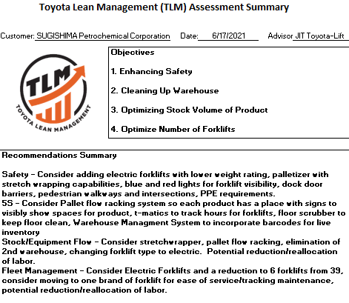
Assessment Summary Based on SUGISHIMA REQUESTS
3

Slide 4
Customer Survey
Requests for the Customer
Clean up warehouse to enhance safety
Optimize Stock Volumes of Product finished goods
Optimize the number of forklifts in operation.
Fact Finding
25’ Clear Height Ceiling
42x48x48 Pallets
3,000 pounds
4 Finished Goods Lines (Basic Production Area)
Currently using 39 LP 5,000 lb Pneumatic Trucks
24/6 operation – 3,000 employees
Estimated total rewards cost per Forklift Operator: $28.96
Estimated total rewards cost per hand palletizers: $24.35
4

Slide 5
Score Summary: current Situation
5

Slide 6
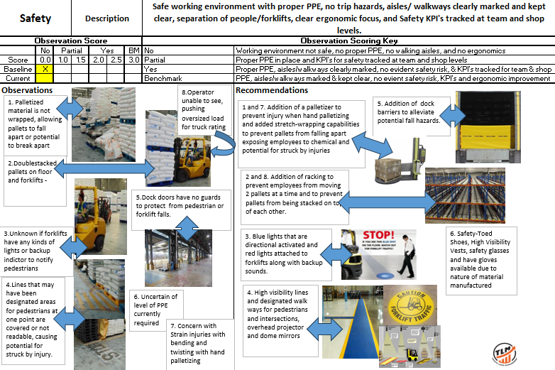
Safety Observations and Opportunities
6

Slide 7
5S Evaluation
7

Slide 8
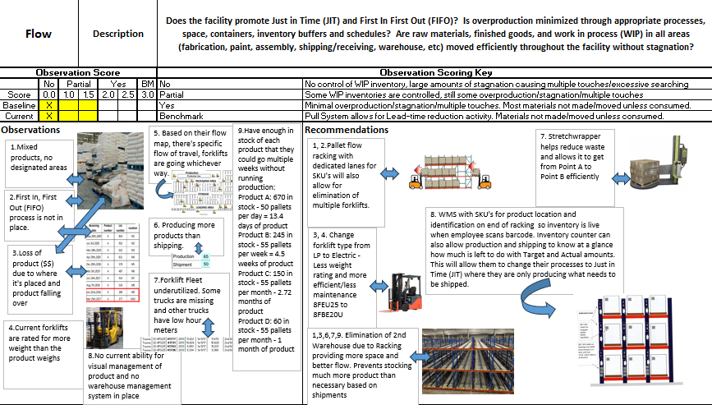
Material/equipment Flow Evaluation
8

Slide 9
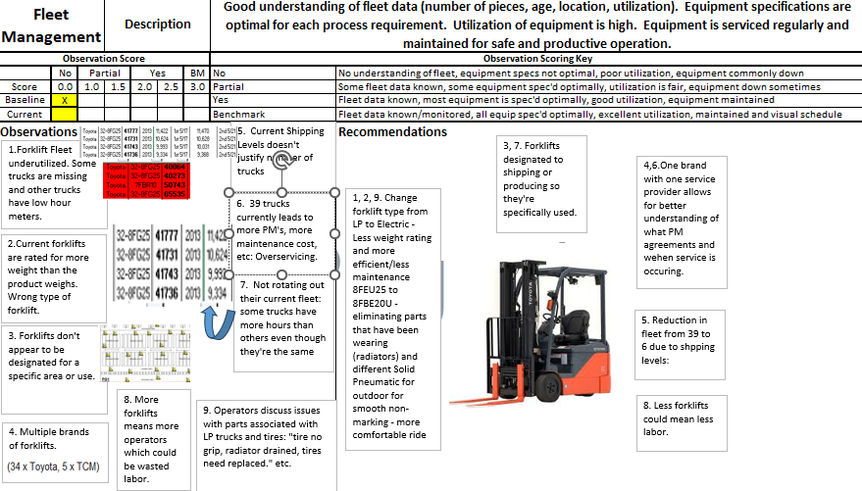
Fleet Management Evaluation
9

Slide 10
Solutions Proposal: Summary
8FBE20U Forklift
Employees will no longer be able to carry two pallets at a time due lower weight limit on forklift, preventing a safety hazard with blocked view and pushing pallets.
Electric forklifts do not have the parts that seem to be wearing on the LP’s – radiators, oil, etc.
Smooth non-marking indoor tires on these forklifts will prevent floor wear, tire wear and make for a more comfortable ride for operators.
New Forklifts renew the life of the fleet and allows for new PM contracts. One brand/service provider makes tracking maintenance easier for SUGISHIMA.
Reduction in size of fleet also means less maintenance and ensures that all forklifts are being utilized to fullest potential
Pallet Flow Racking System
Achieves FIFO by the back of the racking facing Production and the front of the racking facing Shipping.
Pallets are added to the racking from Production and gravity moves them through the racking to the shipping side, ensuring the first pallet in is always the first pallet out.
Saves space by each pallet having its own designated space
Every lane is three levels high with twenty pallets per row
Twelve lanes so each product can have its own section of racking to keep organized.
Electronic signs will be added to each section to label for product placement and to allow changes in the future for spacing if needed.
Prevents operators from moving two pallets at a time because it will not fit in the racking that way.
More space so 2nd warehouse will not be needed – cost savings in fuel, labor, fleet, and utilities. Also allows for materials such as pallets to have a designated space.
Limiting space for pallets with elimination of 2nd warehouse also prevents overproduction of product and reduces square foot cost.
180 pallet positions for each type though more than what is needed for current demand will allow a means to handle future expansion or a spike in sales for each type.
Warehouse Management System
Introduces Live Inventory with barcodes so production and shipping and constantly aware of their daily numbers with a Visual Management System.
Production will scan the code when it leaves production, forklift operator on production side will scan when it hits the racking, Forklift operator on shipping side will scan when it hits the truck.
Target numbers and actual numbers will also be displayed for Production and Shipping based on these scans and inventory so KPI’s are in place.
All decisions based for production should be based on the shipping numbers in the warehouse management system turning it into a true pull system.
10

Slide 11
Solutions Proposal: Summary Continued
Palletizer with Wrapper
Prevents hand palletizing which optimizes safety and prevents employees from touching product unnecessarily.
Wrapping allows product to travel more efficiently without falling or breaking preventing loss in revenue due to damaged product.
Floor Scrubber
Allows for more cleanly environment, keeps walkways and aisles visible for pedestrians.
New Aisleways, Dock Door Barriers, and Projectors
All introduced to optimize safety of pedestrians and forklifts operators.
11

Slide 12
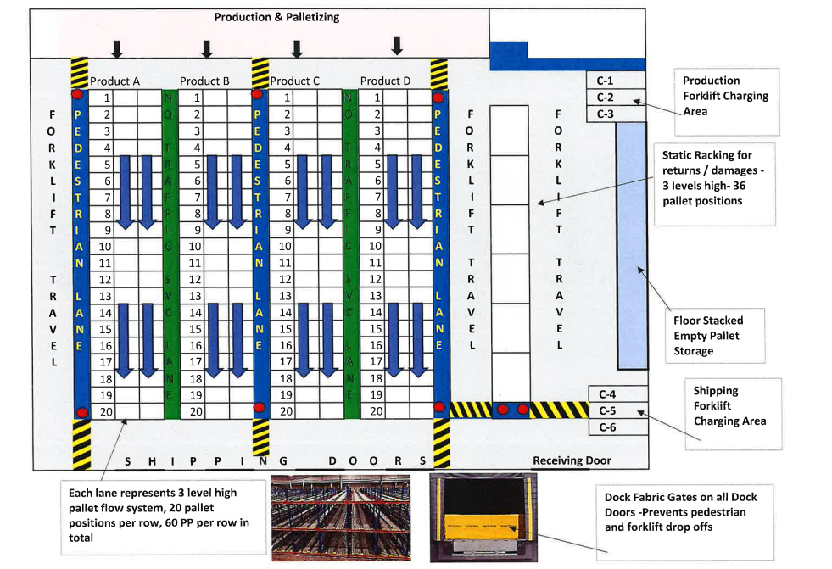
Solutions Proposal: Warehouse Layout
12

Slide 13
Solutions Proposal: Warehouse Layout
13

Slide 14
Solutions Proposal: Warehouse Layout
14

Slide 15
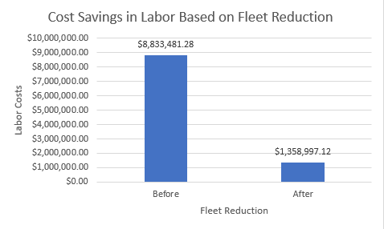
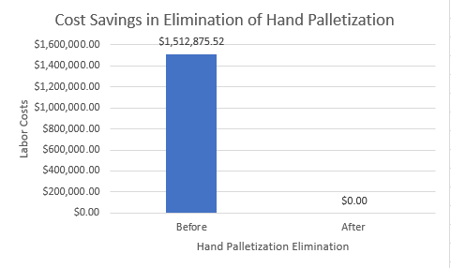
Solutions Proposal: Cost Savings
It is assumed there is 1 operator per forklift per shift. (3 shifts)
The Estimated Rate for a Forklift Operator including benefits was placed at $28.96.
Benefits are assumed to add an average of an additional $4.50 per hour to employee’s rate.
Overtime rate would be the total labor less the benefit times time and a half. ($36.69)
Working 6 days per week, the 6th day would be all Overtime, giving them 40 standard hours, 8 Overtime hours.
Cost Savings: $7,474,484.16 per year.
It is assumed there are 8 hand palletizers per shift. (3 shifts)
The Estimated Rate for a Hand Palletizer including benefits was placed at $24.35.
Benefits are assumed to add an average of an additional $4.50 per hour to employee’s rate.
Overtime rate would be the total labor less the benefit times time and a half. ($29.78)
Working 6 days per week, the 6th day would be all Overtime, giving them 40 standard hours, 8 Overtime hours.
Cost Savings: $1,512,875.52 per year.
15

Slide 16
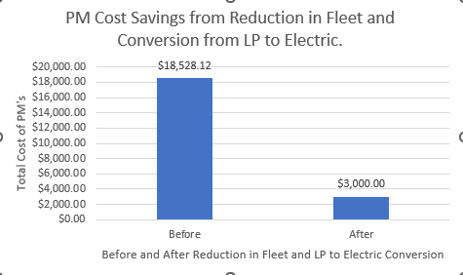
Solutions Proposal: Cost Savings
3PM’s assumed to be completed yearly on LP Trucks based on current equipment hours at 250-300 hours cycle.
Estimated Cost per PM is $158.36 for LP Trucks.
Electric trucks would be on a 500-cycle.
An increase in hours would be seen due to better utilization of the fleet. (4 PM’s per year)
Estimated cost per PM is $125.00 for Electric.
Cost Savings: $15,528.12.
Switching from LP to Electric also provides a cost savings in LP tanks.
Assume 1 tank per shift with an estimated cost of $33.52 per tank
3 Shifts, 6 days a week would have a weekly cost of $23,531.04 in LP tanks that would be saved by going Electric.
16

